Slide 1
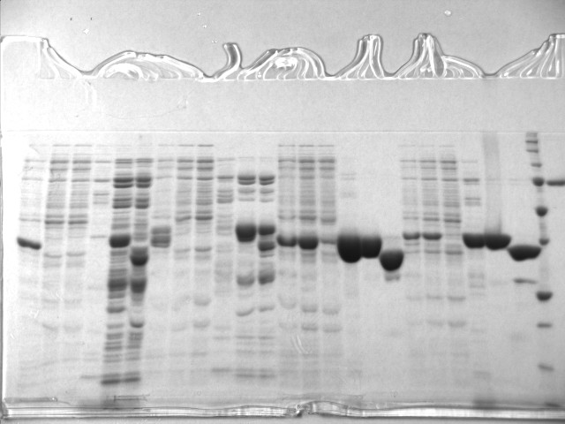
Figure S6. The original SDS-PAGE gel presented in Figure 3b. This image was cropped in the red rectangle. This was made because other purifications were loaded in the same gel.

Slide 2
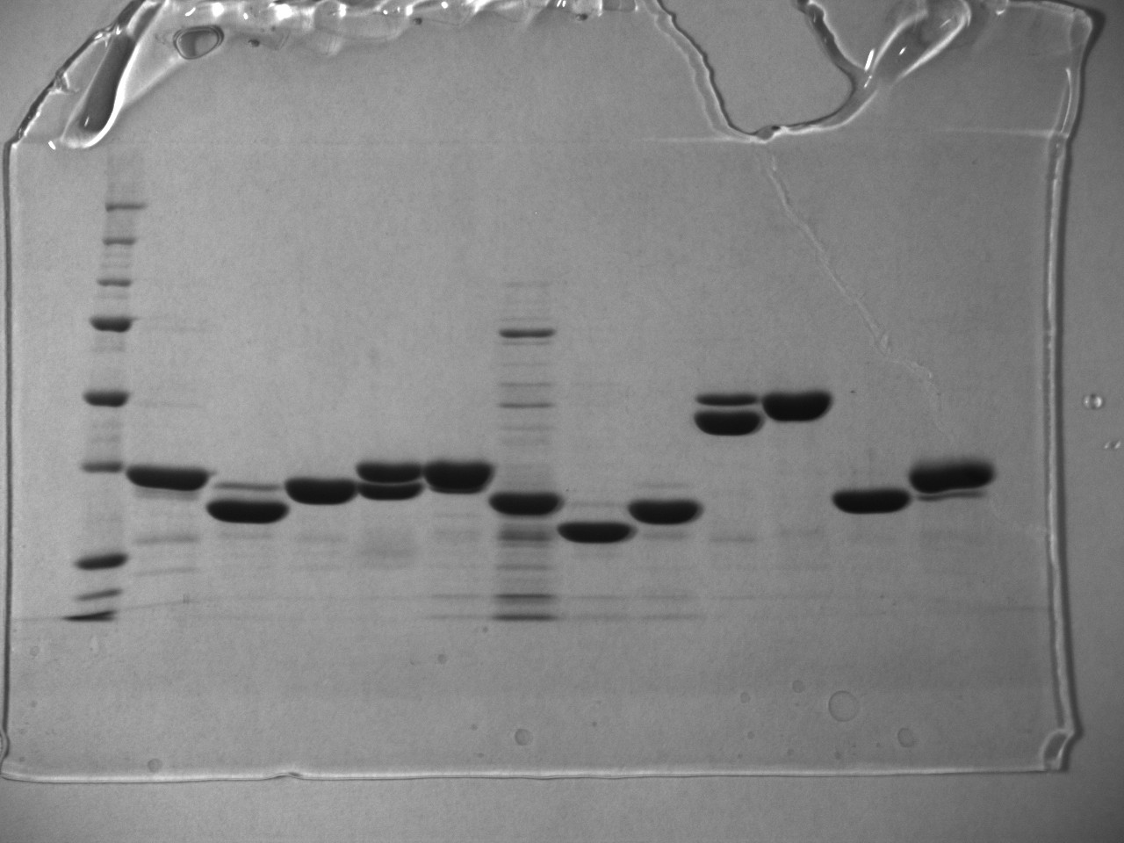
Figure S7. The original SDS-PAGE gel presented in Figure 3b, for the gel filtration purified ZmDRIK1-KD^{R187-S514}. This image was cropped in the red rectangle. This was made because other purified proteins were loaded in the same gel.

